Slide 1
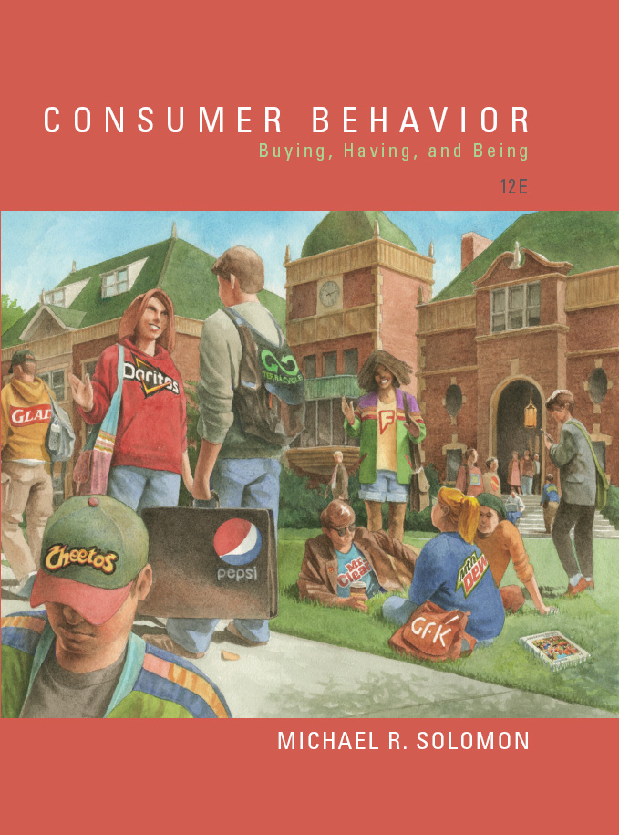
Consumer Behavior: Buying, Having, and Being
Twelfth Edition
Chapter 1
Buying, Having, and Being: An Introduction to Consumer Behavior
Copyright © 2017, 2015, 2013 Pearson Education, Inc. All Rights Reserved.
Notes:
If this PowerPoint presentation contains mathematical equations, you may need to check that your computer has the following installed:
1) MathType Plugin
2) Math Player (free versions available)
3) NVDA Reader (free versions available)
This chapter defines the scope of international business and introduces us to some of its most important topics.

Slide 2
Learning Objectives (1 of 2)
1.1 Consumer behavior is a process.
1.2 Marketers have to understand the wants and needs of different consumer segments.
1.3 Our choices as consumers relate in powerful ways to the rest of our lives.
1.4 Our motivations to consume are complex and varied.
1.5 Technology and culture create a new “always on” consumer.

Slide 3
Learning Objectives (2 of 2)
1.6 Many different types of specialists study consumer behavior.
1.7 There are differing perspectives regarding how and what we should understand about consumer behavior.

Slide 4

Learning Objective 1.1
Consumer behavior is a process.
Notes:
In the early stages of development, researchers referred to the field as buyer behavior. Marketers now recognize that consumer behavior is an ongoing process, not merely what happens at one point in the transaction cycle. We call the transaction of value between two or more an exchange. It’s an integral part of marketing but consumer behavior recognizes that the entire consumption process is relevant for marketers. Figure 1.1 illustrates these issues.

Slide 5
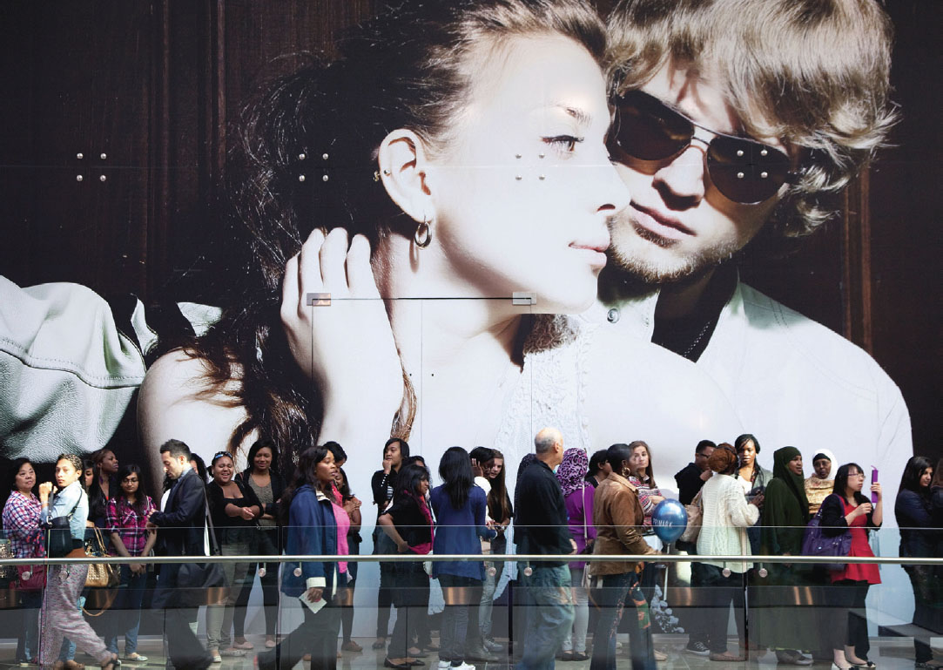
People in the Marketplace
Consumption Communities
Market Segmentation Strategies
Notes:
consumption communities are where members share opinions and recommendations about anything from Barbie dolls to baseball fantasy league team lineups to iPhone apps.
The use of market segmentation strategies means an organization targets its product, service, or idea only to specific groups of consumers rather than to everybody—even if it means that other consumers who don’t belong to this target market aren’t attracted to it. That’s why they make chocolate and vanilla ice cream (and even candied bacon flavor!).

Slide 6
What Is Consumer Behavior?
The study of the processes involved when individuals or groups select, purchase, use, or dispose of products, services, ideas, or experiences to satisfy needs and desires.

Slide 7
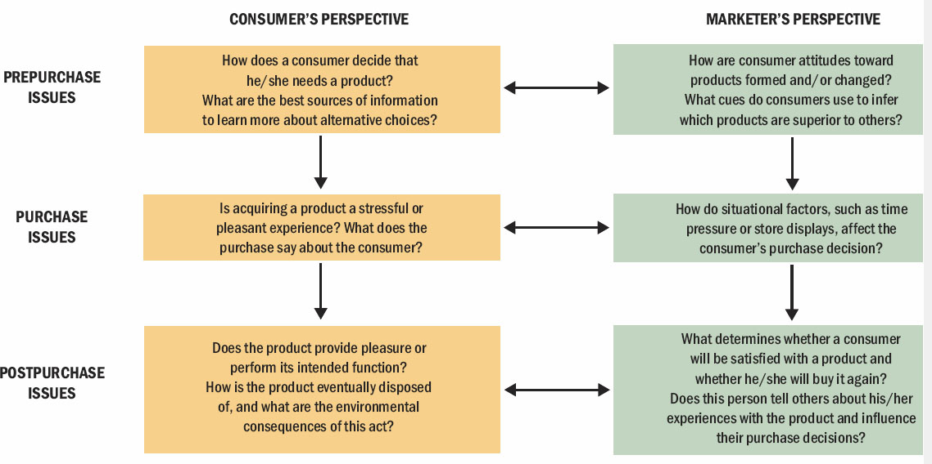
Figure 1.1 Stages in the Consumption Process
Notes:
We call the person who identifies a need or desire, makes a purchase, and then disposes of the product as a consumer. The purchaser or user might be the same person, or not. You can see in the slide that there are three key stages: 1) prepurchase, 2) purchase, and 3) postpurchase. Marketers need an understanding of all three stages.

Slide 8
For Reflection (1 of 6)
How do you decide that you need a product?
What about a purchase makes it pleasant or stressful for you?
When using the product, what determines if the experience is pleasant?

Slide 9
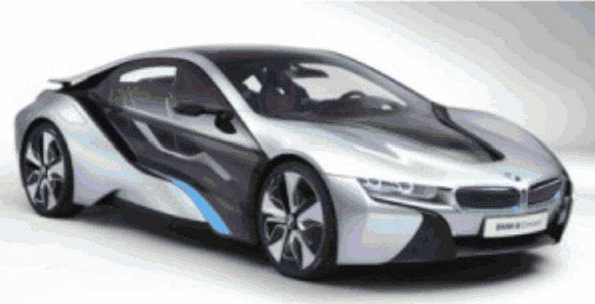
Learning Objective 1.2
Marketers have to understand the wants and needs of different consumer segments.
Notes:
Marketers must understand the various consumer segments they are targeting in order to meet the segments’ needs. In the ad shown, the woman is fed up with bad financial news. Bianco adjusted its message strategy to address the concerns of its audience.
Many dimensions are relevant for understanding consumer needs and wants. Usage (whether heavy or light) can help to focus marketers’ energies. In addition there are many demographic variables that can help in understanding groups of consumers.

Slide 10
Consumers Are Different
Heavy Users
80/20 Rule
Notes:
Heavy users are the most faithful customers
80/20 rule – 20% of users account for 80% of sales

Slide 11
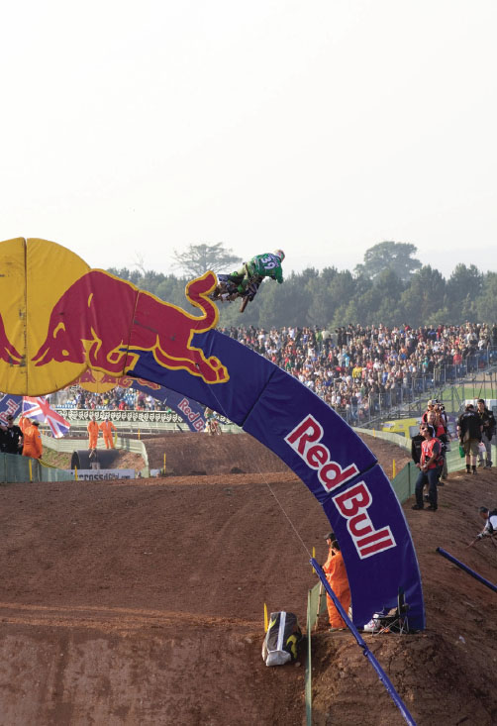
Segmenting Consumers: Demographics
Demographics:
Age
Gender
Family structure
Social class/income
Race/ethnicity
Geography
Lifestyles
Notes:
Demographics are statistics that measure observable aspects of a population. Some of the most common demographic measures are age, gender, family structure, social class, race or ethnicity, and geography. Even lifestyles can be useful to marketers in that consumers may share demographic characteristics but have very different lifestyles. Marketers try to understand their customers and develop lifelong relationships. Marketers who follow this approach are said to follow the philosophy of relationship marketing.
They may also utilize database marketing in order to track consumers’ buying habits.

Slide 12
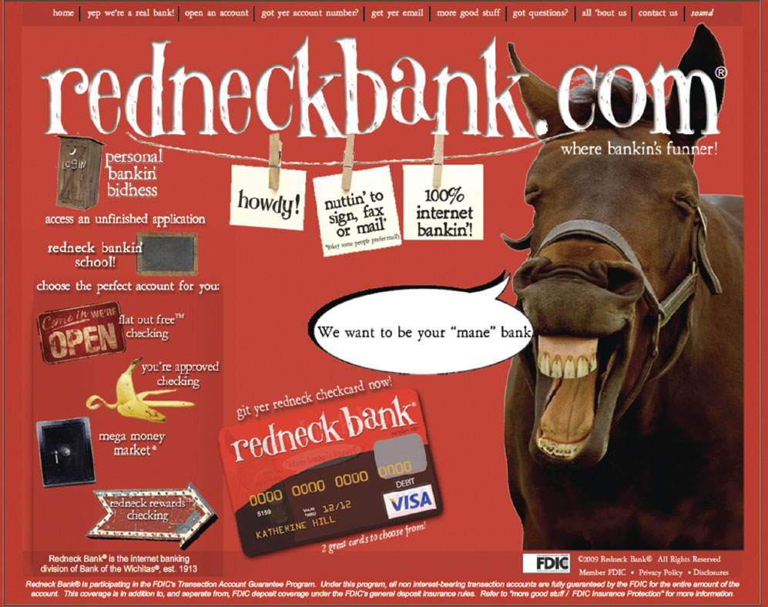
Redneck Bank Targets by Social Class
Notes:
People who belong to the same social class are approximately equal in terms of their incomes and social standing in the community. This bank boastfully targets rednecks.

Slide 13
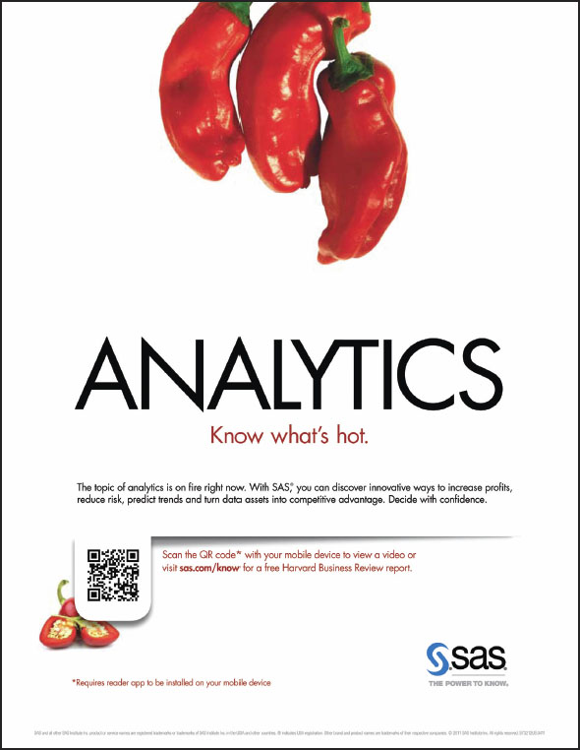
Big Data
Database Marketing
Relationship Marketing
Notes:
Database marketing tracks specific consumers’ buying habits very closely and crafts products and messages tailored precisely to people’s wants and needs based on this information. The collection and analysis of extremely large datasets is called Big Data. In a single day, consumers create 2.5 quintillion bytes of data. Big Data can influence many areas of consumer life. For instance, monitoring of Google searches for fever and flu can help epidemiologists to identify specific areas of the US that have been hit by flu outbreaks even before patients begin visiting doctors and hospitals.

Slide 14

Learning Objective 1.3
Our choices as consumers relate in powerful ways to the rest of our lives.
Notes:
Marketing influences popular culture and popular culture influences marketing.

Slide 15
Popular Culture
Music
Movies
Sports
Books
Celebrities
Entertainment
Marketers influence preferences for movie and music heroes, fashions, food, and decorating choices.
Notes:
Many people don’t realize the extent to which marketers influence popular culture. Whether we are talking about music, movies, sports, or entertainment, these forms of popular culture both influence and are influenced by marketing.

Slide 16
Consumer-Brand Relationships
Role Theory
Self-concept attachment
Nostalgic attachment
Interdependence
Love
Notes:
Role theory takes the view that much of consumer behavior resembles actions in a play.
We find that consumers may develop relationships with brands over time. The slide lists some of the types of relationships we may see between consumers and their brands.
Self-concept attachment means that the product helps to establish the user’s identity. This was one of our early points in this chapter.
Nostalgic attachment means the product serves as a link to the consumer’s past.
Interdependence means that the product is a part of the user’s daily routine.
Love means that the product elicits emotional bonds of warmth, passion, or other strong emotion.

Slide 17
For Reflection (2 of 6)
What kind of relationship do you have with your car?
Do these feelings correspond to the types of relationships consumers may develop with products?
How do these relationships affect your behavior?
Notes:
Reduces marketing costs: Companies that sell global products can reduce costs by standardizing certain marketing activities. Companies can achieve further cost savings by keeping an ad’s visual component the same for all markets but dubbing TV ads and translating print ads into local languages.
Creates new market opportunities: A company that sells a global product can explore opportunities abroad if its home market is small or becomes saturated.
Levels uneven income streams: A company that sells a product with universal, but seasonal, appeal can use international sales to level its income stream.
Local buyers’ needs: In the pursuit of the potential benefits of global markets, managers must constantly monitor the match between the firm’s products and markets in order to not overlook the needs of buyers. The benefit of serving customers with an adapted product may outweigh the benefit of a standardized one.
Global sustainability: Another need that multinationals must consider is the need among all the world’s citizens for sustainability—development that meets the needs of the present without compromising the ability of future generations to meet their own needs.

Slide 18
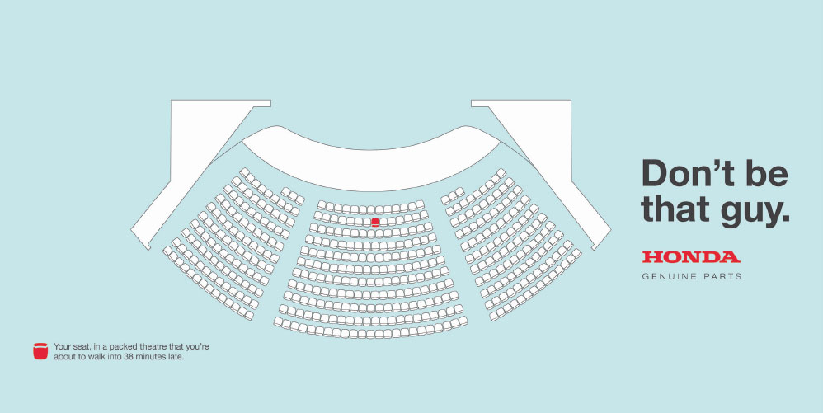
Learning Objective 1.4
Our motivations to consume are complex and varied.
Notes:
People often buy products not for what they do but for what they mean. Products play an extended role in our lives. Motivation refers to the processes that lead people to behave as they do. It occurs when a need is aroused that the consumer wishes to satisfy.

Slide 19
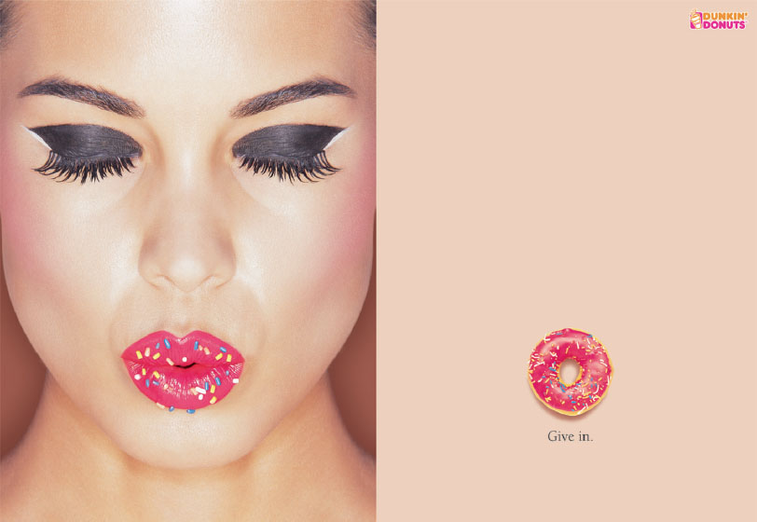
Motivation
Need Vs. Want
Notes:
Motivation refers to the processes that lead people to behave as they do. It occurs when a need is aroused that the consumer wishes to satisfy. The need creates a state of
tension that drives the consumer to attempt to reduce or eliminate it. This need may be utilitarian (i.e., a desire to achieve some functional or practical benefit, as when a person loads up on green vegetables for nutritional reasons) or it may be hedonic (i.e., an experiential need, involving emotional responses or fantasies)

Slide 20
For Reflection (3 of 6)
Describe a need and a want you have and explain the motivation for the want.

Slide 21
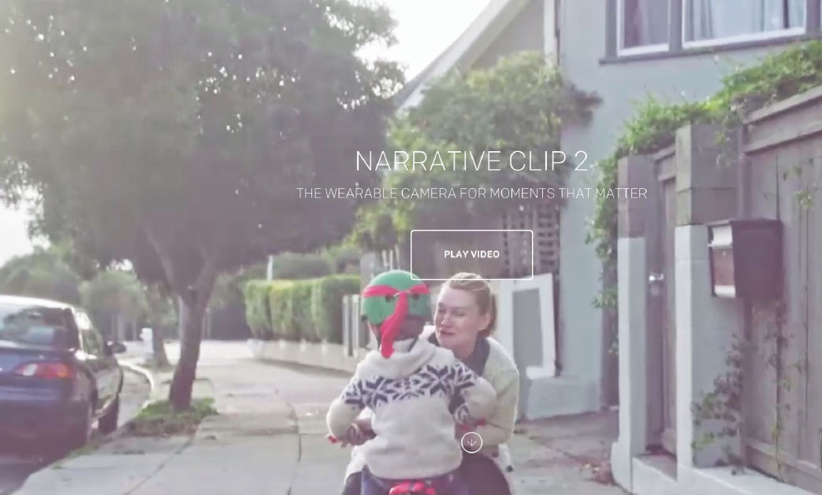
Learning Objective 1.5
Technology and culture create a new “always on” consumer.
Notes:
Access to the Internet is incredibly influential for consumer behavior. It changes who you may interact with, the information you can find, the choices you see as available, and the time and energy you spend dealing with various decisions. The Internet has made it possible for businesses to use an additional channel of distribution (B2C e-commerce) but it’s also made possible C2C e-commerce, in the form of outlets like Etsy.com.
You are likely at the forefront of the impact of the Web on consumer behavior because you are a digital native. Digital natives grew up in a wired world.
The Web hasn’t just changed consumer behavior by shifting our options in terms of channels of distribution. It’s also made possible a whole new form of media known as social media.

Slide 22
The Digital Native: Living a Social [Media] Life
B2C e-commerce
C2C e-commerce
Digital Native
Synchronous interactions
Asynchronous interactions
Notes:
The term digital native originated in a 2001 article to explain a new type of student who was starting to turn up on campus. These consumers grew up “wired” in a highly networked, always-on world where digital technology had always existed
synchronous interactions (those that occur in real time, like when you text backand- forth with a friend) and asynchronous interactions (those that don’t require all
participants to respond immediately, like when you text a friend and get an answer the next day)

Slide 23
For Reflection (4 of 6)
How has your daily life changed because of social media?
What does your virtual life look like?

Slide 24
Learning Objective 1.6 (1 of 2)
Many specialists study consumer behavior.
Table 1.1 Interdisciplinary Research Issues in Consumer Behavior
Disciplinary Focus | Magazine Usage Sample Research Issues
Experimental Psychology: product role in perception, learning, and memory processes | How specific aspects of magazines, such as their design or layout, are recognized and interpreted; which parts of a magazine people are most likely to read.
Clinical Psychology: product role in psychological adjustment | How magazines affect readers’ body images (e.g., do thin models make the average woman feel overweight?)
Microeconomics/Human Ecology: product role in allocation of individual or family resources | Factors influencing the amount of money a household spends on magazines.
Social Psychology: product role in the behavior of individuals as members of social groups | Ways that ads in a magazine affect readers’ attitudes toward the products depicted; how peer pressure influences a person’s readership decisions
Sociology: product role in social institutions and group relationships | Pattern by which magazine preferences spread through a social group (e.g., a sorority)
Notes:
Table 1.1 illustrates the interdisciplinary nature of consumer behavior.

Slide 25
Learning Objective 1.6 (2 of 2)
[Table 1.1 continued]
Disciplinary Focus | Magazine Usage Sample Research Issues
Macroeconomics: product role in consumers’ relations with the marketplace | Effects of the price of fashion magazines and expense of items advertised during periods of high unemployment
Semiotics/Literary Criticism: product role in the verbal and visual communication of meaning | Ways in which underlying messages communicated by models and ads in a magazine are Interpreted
Demography: product role in the measurable characteristics of a population | Effects of age, income, and marital status of a magazine’s readers
History: product role in societal changes over time | Ways in which our culture’s depictions of “femininity” in magazines have changed over time
Cultural Anthropology: product role in a society’s beliefs and practices | Ways in which fashions and models in a magazine affect readers’ definitions of masculine versus feminine behavior (e.g., the role of working women, sexual taboos)

Slide 26
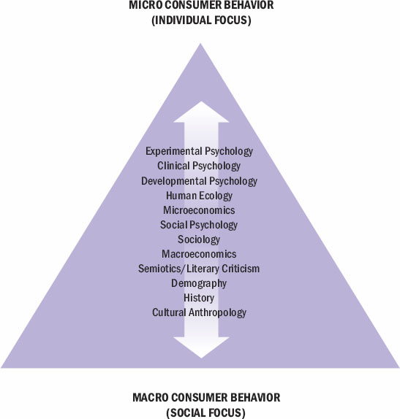
Figure 1.2 The Pyramid of Consumer Behavior
Notes:
This figure provides a glimpse at some of the disciplines working in the field and the level at which each tackles research issues. The fields closer to the top of the pyramid concentrate on individual behavior. Those toward the base are more interested in the aggregate activities that occur among large groups of people.

Slide 27
For Reflection (5 of 6)
Pick two of the disciplines shown in Figure 1.2. How would their approaches to the same marketing issue differ?

Slide 28
Learning Objective 1.7
There are differing perspectives regarding how and what we should understand about consumer behavior.
Notes:
We call a set of beliefs that guide our understanding of the world a paradigm. Some belief consumer behavior is in the midst of a paradigm shift, which occurs when a competing paradigm challenges the dominant set of assumptions. The basic set of assumptions underlying the dominant paradigm is positivism or modernism. It emphasizes that human reason is supreme and there is a single, objective truth that science can discover.
The newer paradigm of interpretivism (or postmodernism) questions these assumptions. This perspective argues that societal beliefs deny the complex social and cultural world in which we really live.

Slide 29
Positivist vs. Interpretivist
Table 1.2 Positivist versus Interpretivist Approaches to Consumer Behavior
Assumptions | Positivist Approach | Interpretivist Approach
Nature of reality Goal | Objective, tangible Single Prediction | Socially constructed Multiple understanding
Knowledge Generated | Time-free, context Independent | Time-bound, context dependent
View of Causality | Existence of real Causes | Multiple, simultaneous shaping events
Research Relationship | Separation between researcher and subject | Interactive, cooperative with researcher being part of phenomenon under study
Notes:
Pastiche is a mixture of images and ideas in the interpretivist view. Consumer culture theory (CCT) refers generally to research that regards consumption from a social and cultural point of view rather than more narrowly as an economic exchange.

Slide 30
For Reflection (6 of 6)
How do you think the two paradigms of consumer research affect the choices marketers make in targeting consumer segments?

Slide 31
Chapter Summary
Consumer behavior is a process.
Marketers have to understand the wants and needs of different consumer segments.
Our choices as consumers relate in powerful ways to the rest of our lives.
Our motivations to consume are complex and varied.
Technology and culture create a new “always on” consumer.
Many different types of specialists study consumer behavior.
There are differing perspectives regarding how and what we should understand about consumer behavior.

Slide 32

Copyright

